Slide 1

DriverPass System Analysis
Jeremy Schultz
Notes:
[No speaker notes required for this slide.]

Slide 2

System Requirements
Functional Requirements
The system lets customers schedule driving lessons.
The system tracks practice test scores and progress.
Nonfunctional Requirements
The system loads pages fast and runs smoothly.
The system keeps all data secure and encrypted.
Notes:
I picked two simple functional requirements basically the things the system has to do. Scheduling lessons is one of the main things DriverPass wanted, and tracking practice test scores is a big part of helping people prepare for their DMV test.
For the nonfunctional requirements, I chose speed and security. DriverPass needs the system to run smoothly so customers don’t get frustrated, and security is obviously important since people’s personal info and test results are stored in the system.
Overall, these requirements match exactly what DriverPass asked for: a fast, secure system that helps customers book lessons and improve their driving test scores.

Slide 3
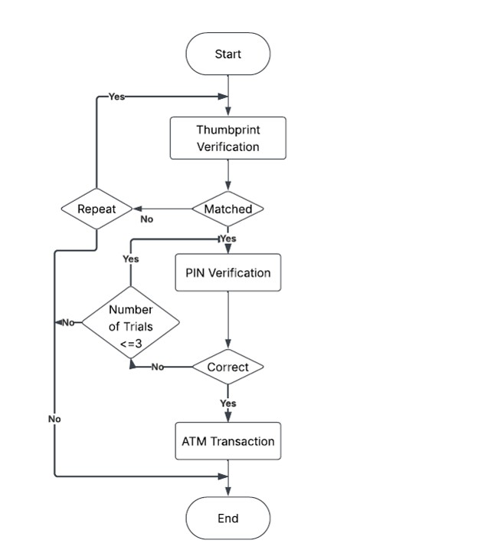
Use Case Diagram
Notes:
I mapped out everyone who uses DriverPass and what they actually need the system to do.
-Customers are just trying to sign up, schedule lessons, take practice tests, and see how they’re doing.
-Staff need to manage appointments, enter lesson notes, and check customer info.
-The owner needs to turn packages on/off and look at reports.
-The DMV sends updated rules and test questions.
I made sure the diagram covers all the stuff DriverPass said they wanted like online scheduling, practice tests, progress tracking, staff tools, and automatic DMV updates.

Slide 4
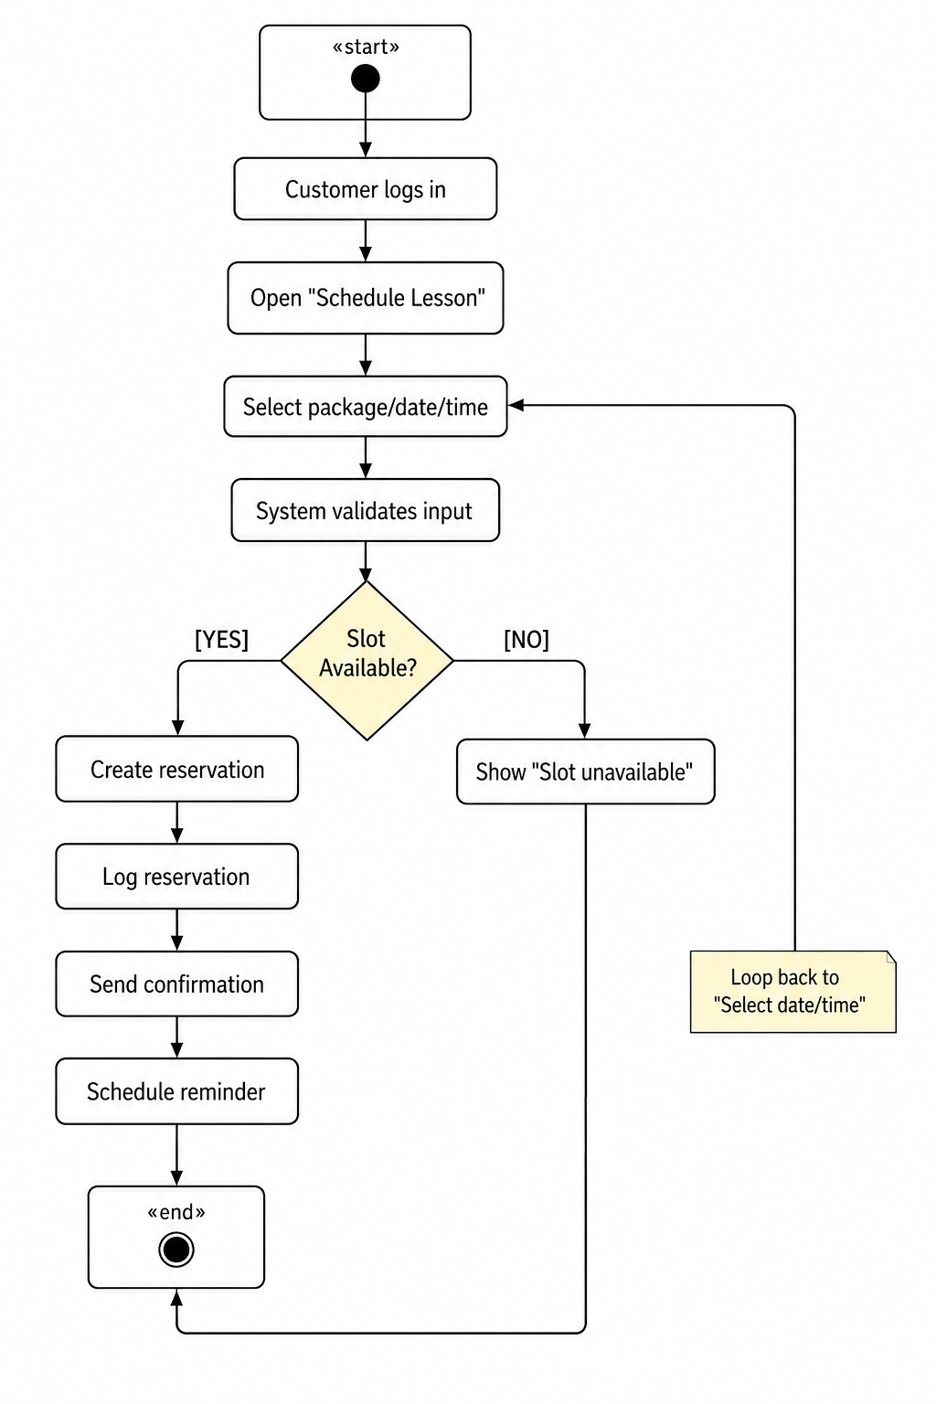
Activity Diagram
Notes:
I focused on the part where a customer schedules a driving lesson. It’s basically the whole flow from logging in, picking a package and time, and the system checking if that spot is open. If it is, it books it and sends a confirmation. If not, it tells them to pick another time.
I built it this way because DriverPass really needs a smooth, easy scheduling process. The diagram shows exactly how the system handles that by checking availability, keeping things organized, and making sure customers get clear feedback.

Slide 5
Security
Login requires email + password
Accounts lock after too many failed attempts
All data is encrypted
Staff access is limited based on their role
Notes:
I made sure security wasn’t an afterthought. I kept things simple but solid. First, people have to log in with their email and password, and the system locks the account if someone keeps trying the wrong password. That helps stop anyone from messing with someone else’s account.
I also made sure all the important info like customer details, lesson notes, and test scores stays encrypted so nobody can just grab it. And staff only see what they’re supposed to see based on their job. Overall, the design keeps customer data safe while still being easy to use, which is exactly what DriverPass needs.

Slide 6
System Limitations
Depends on DMV updates being accurate and on time
Needs stable internet for customers and staff
High traffic could slow things down
Some advanced features may not fit the budget right away
Notes:
The system relies on the DMV sending updated rules, so if they’re slow, DriverPass is stuck waiting. It also needs people to have decent internet, which isn’t always guaranteed. If a ton of users jump on at once, things could lag a bit. And since DriverPass is a smaller company, some of the “nice to have” features might not fit the budget right away.

